Slide 2
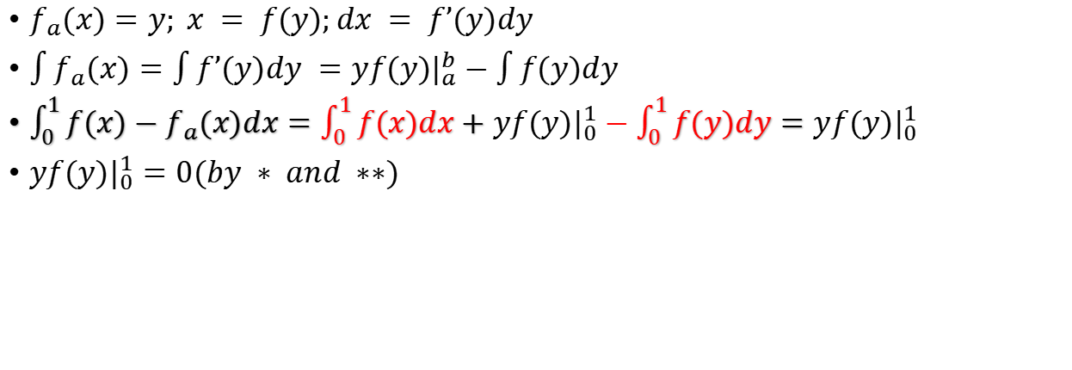
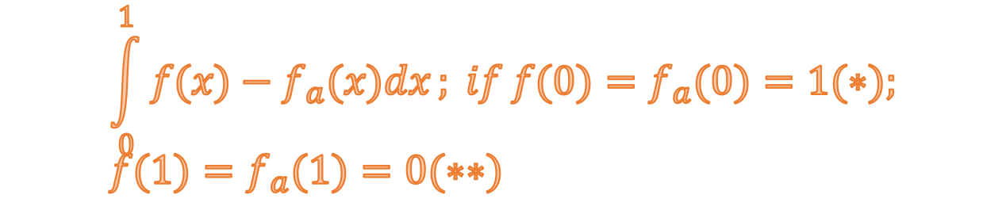
$$\int_{0}^{1}{f(x)−f_{a}(x)dx}; if f(0)=f_{a}(0)=1(∗); \\ f(1)=f_{a}(1)=0(∗∗)$$
$f_{a}(x)=y; x = f(y);dx = f’(y)dy$
$\int{f_{a}(x)}=\int{f’(y)dy }=yf(y)|_{a}^{b}−\int{f(y)dy}$
$\int_{0}^{1}{f(x)−f_{a}(x)dx}=\int_{0}^{1}{f(x)dx}+yf(y)|_{0}^{1}−\int_{0}^{1}{f(y)dy}=yf(y)|_{0}^{1}$
$yf(y)|_{0}^{1}=0(by ∗ and ∗∗)$

Slide 3
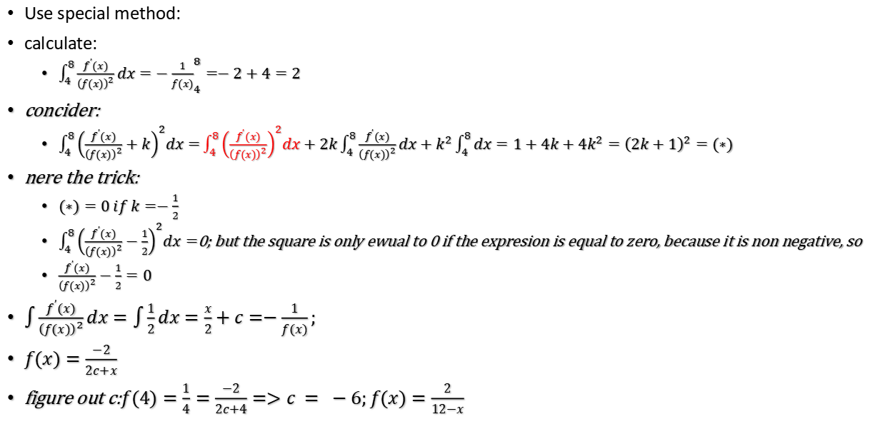

$$f(4)=\frac{1}{4}:f(8)=\frac{1}{2};\int_{4}^{8}{\frac{{\left(f^{’}(x)\right)}^{2}}{{\left(f(x)\right)}^{4}}}dx=1$$
Use special method:
calculate:
$\int_{4}^{8}{\frac{f^{’}(x)}{{\left(f(x)\right)}^{2}}dx}={−\frac{1}{f(x)}}_{4}^{8}=−2+4=2$
concider:
$\int_{4}^{8}{{\left(\frac{f^{’}(x)}{{\left(f(x)\right)}^{2}}+k\right)}^{2}dx=}\int_{4}^{8}{{\left(\frac{f^{’}(x)}{{\left(f(x)\right)}^{2}}\right)}^{2}dx}+2k\int_{4}^{8}{\frac{f^{’}(x)}{{\left(f(x)\right)}^{2}}dx}+k^{2}\int_{4}^{8}{dx}=1+4k+4k^{2}={\left(2k+1\right)}^{2}=(∗)$
nere the trick:
$(∗)=0 if k=−\frac{1}{2}$
$\int_{4}^{8}{{\left(\frac{f^{’}(x)}{{\left(f(x)\right)}^{2}}−\frac{1}{2}\right)}^{2}dx=}$0; but the square is only ewual to 0 if the expresion is equal to zero, because it is non negative, so
$\frac{f^{’}(x)}{{\left(f(x)\right)}^{2}}−\frac{1}{2}=0$
$\int{\frac{f^{’}(x)}{{\left(f(x)\right)}^{2}}}dx=\int{\frac{1}{2}dx}=\frac{x}{2}+c=−\frac{1}{f(x)};$
$f(x)=\frac{−2}{2c+x}$
figure out c:$f(4)=\frac{1}{4}=\frac{−2}{2c+4}=>c = −6;f(x)=\frac{2}{12−x}$

